Slide 1
Kings County Housing Data Analysis
Joongsuk Jin
3/12/2019

Slide 2
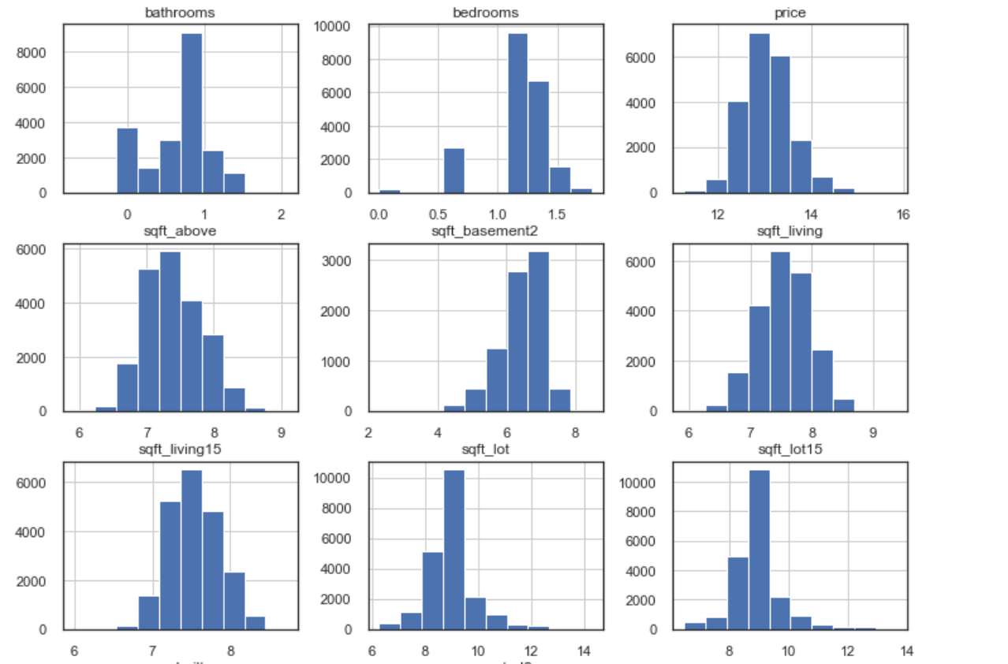
Purpose of Modeling/Analysis
Choose highly correlated variables to predict ‘price’ variables
Create a model to best explain the target variable

Slide 3
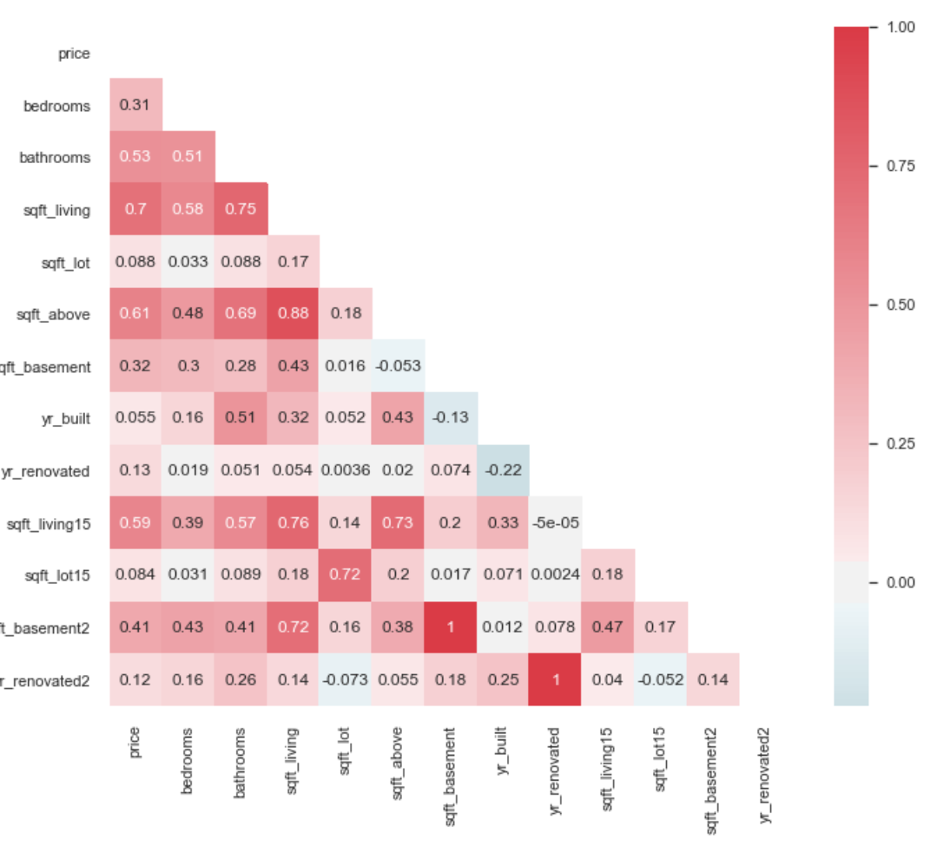
Feature Selection Approach
Highest correlation to target ‘price’ variables
Preserve as much as data while scrubbing
Consider interference between predicting features

Slide 4
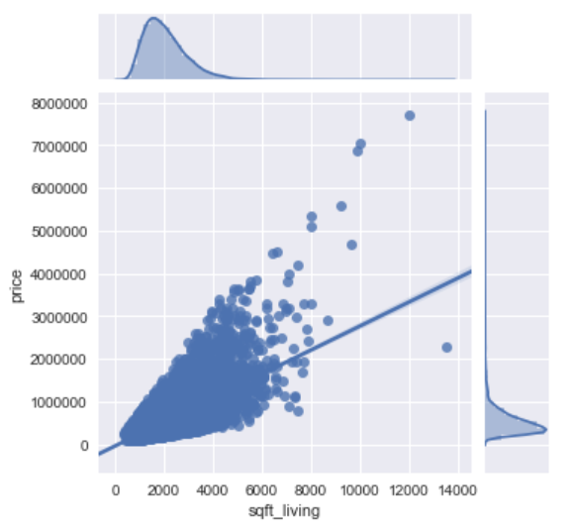
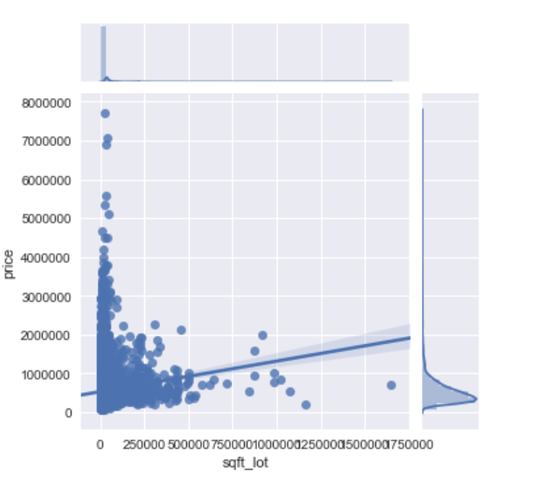
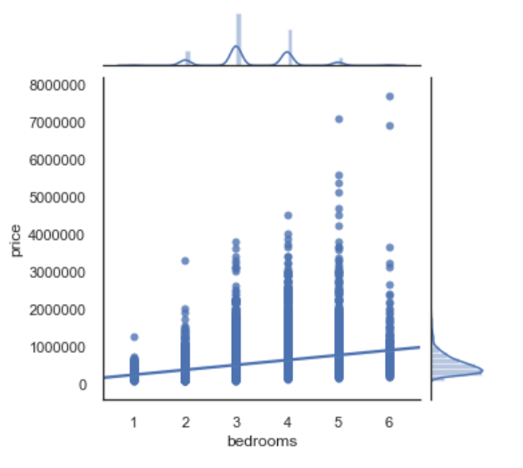
Final Selected Features
Bedrooms
Sqft_living
Sqft_lot

Slide 5
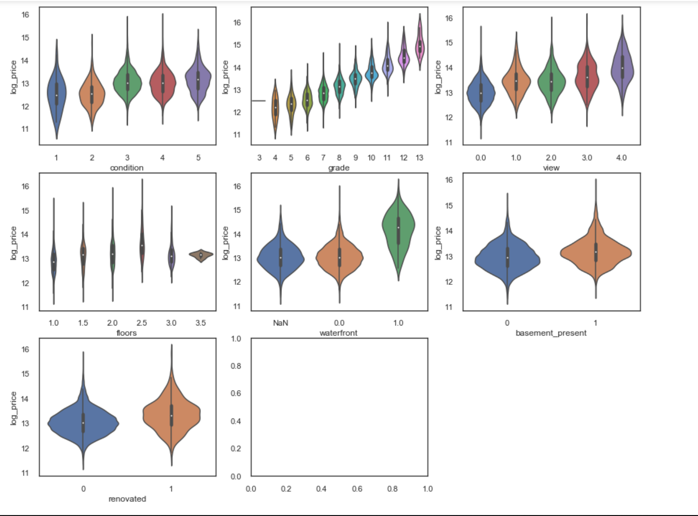
Final Selected Features
Floors , Views, Grade

Slide 6
Conclusion
The model has produced a fairly good results
Things to consider for improvement
- location information (lat, long)
- different modeling method and comparison

